Slide 1
Phishing Email Detection
By Hung Do, Leland Ly, and Andy Chek

Slide 2
Project Overview
Phishing is when scammers use email or text messages to try to steal people’s passwords, account numbers, or Social Security numbers.
We plan to use our analysis to review an email dataset to classify if an email is a phishing one based on a keyword detection model
It could be used to help people understand how natural language processing works in terms of detecting scams.

Slide 3
The Team
Leland:
Computer Science, Software Engineering, Artificial Intelligence
Developed vocabulary classification learning model
Andy:
Computer Science, Software Engineering, Artificial Intelligence, Web Development, Math
Developed phishing classification model based on punctuation usage heuristic
Hung:
Computer Science, Software Engineering, Artificial Intelligence, Math
Found and created tests outside of the dataset

Slide 4
Repo and Data Used
Repo: https://github.com/DoNguyenHung/DSCI-Phishing-Email-Detection
Data:
Phishing Email Detection, Detecting Phishing Emails by Text Analytics
https://www.kaggle.com/datasets/subhajournal/phishingemails/code?resource=download
3 columns: an ID number, a blurb of unformatted text, and a boolean showing if the text is phishing or not.

Slide 6

Stakeholders and Intentions
Stakeholders:
Middle-aged and senior workers
Intentions:
Assist and grow awareness on the elements to identify a phishing email and other social engineering mechanisms
Beneficial to detecting other types of technology scams
Pop-up scams
Fake websites

Slide 7

Vocabulary Classification
One of the main detectors of a spam email is its vocabulary.
“Free cash”
“Meet singles”
“Last Chance”
If we train a Bayes model on data, it should be able to detect if a string or email contains a significant number of these trigger words, and categorize it as phishing.
Used the above Kaggle dataset, with a 80/20 train test split.
Cleaned the data with NLTK
Built model with SkLearn TfidfVectorizer and MultinomialNB

Slide 8

Punctuation Classification
Another detector of a potentially phishing email is its usage of punctuation.
Overwhelmingly detailed sentences vs. short and concise sentences
Weird or unnecessary punctuation usage
It should be able to detect if an email is phishing based on counts of punctuation types (periods, commas, exclamations, questions)
Used the same Kaggle dataset and test/train split as the vocabulary classification
Data reduced to instances of punctuation
Built model by feeding features and targets in a MultinomialNB model

Slide 9
Outside tests
Attempted to add tests that are outside the database
Included both safe and phishing emails
Used both the trained vocabulary and punctuation models to predict.

Slide 10
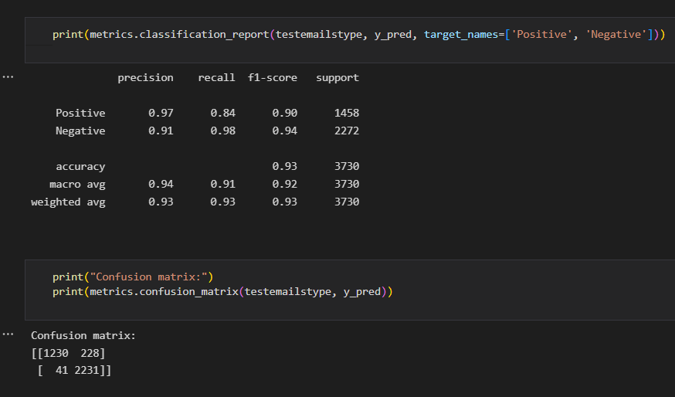
Vocabulary Results
Of 3730 test values:
32.9222520107% true positive
59.9463806971% true negative
5.92493297587% false positive
1.20643431635% false negative
A 92.8686327078% detection rate.

Slide 11
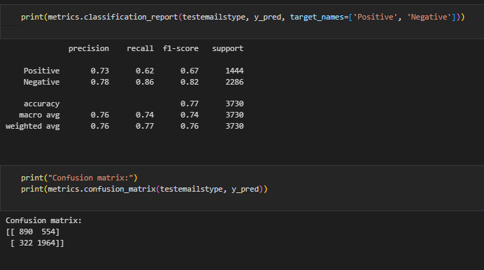
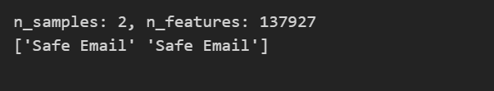
Punctuation Results
3730 test values
23.86058981233244% True Nositive
52.65415549597855% True Negative
14.85254691689008% False Negative
8.632707774798927% False Positive
76.51474531% correct detection
Testing
Both cases are found to be safe emails
50% accuracy

Slide 12
Challenges, Issues, and Limitations
Dataset:
No pictures, links
Dirty data, sometimes crashing Excel
Potentially needing to expand beyond emails, such as from text messages and phone call logs
Algorithm:
Punctuation: not understood as vocabulary
Doesn’t work really well with tests outside the dataset

Slide 13
Thank you for watching!

